Slide 1
Histogram Equalization and Matching

Slide 2
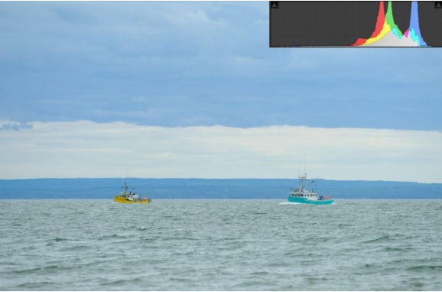

HISTOGRAM EQUALIZATION
The fundamental idea of histogram equalization is to improve contrast of an image.
Histogram equalization is a point process that redistributes the image's intensity distributions in order to obtain a uniform histogram for the image.
Truly uniformed histograms for discrete images are difficult to obtained because of quantization . So we are going to implement the following formula to get the new pdf:
Low contrast image

Slide 3
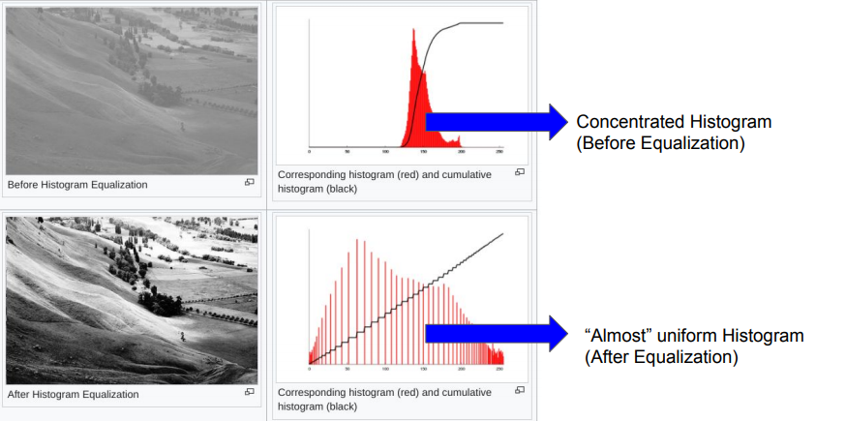

Slide 4
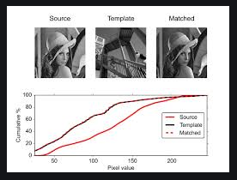
HISTOGRAM MATCHING
In image processing, histogram matching or histogram specification is the transformation of an image so that its histogram matches a specified histogram.
Histogram equalization method is a special case in which the specified histogram is uniformly distributed.

Slide 5
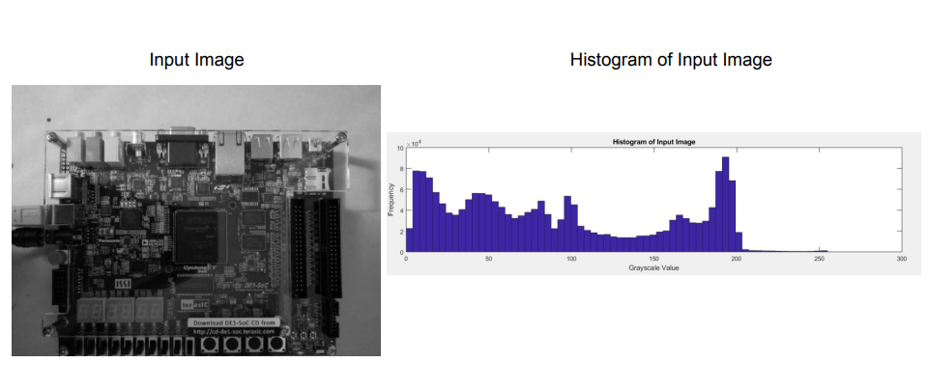
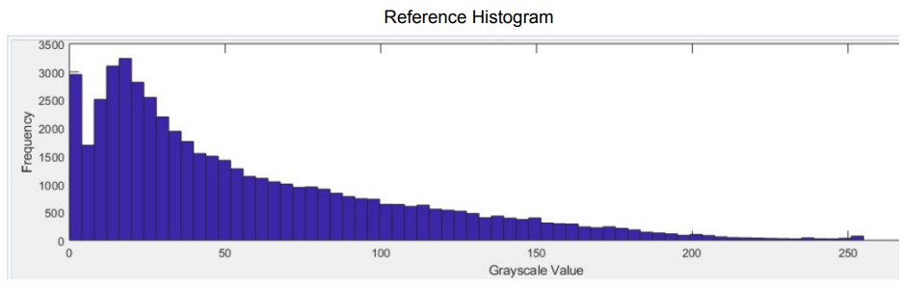

Slide 6
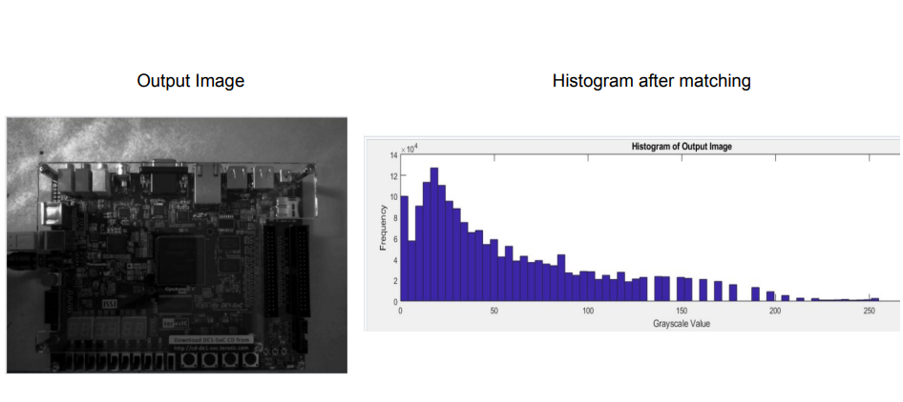

Slide 7
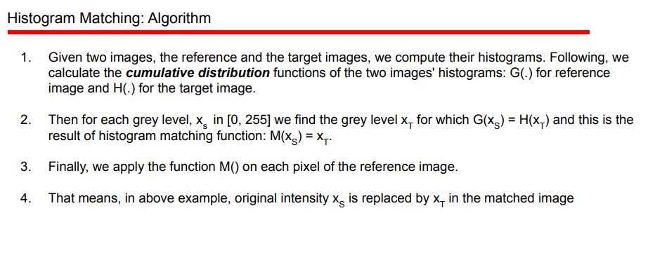

Slide 8
